Slide 1
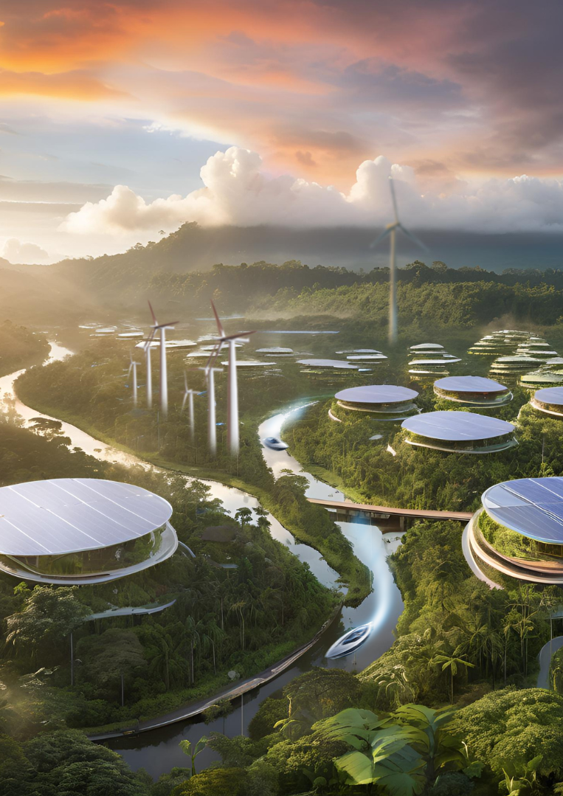

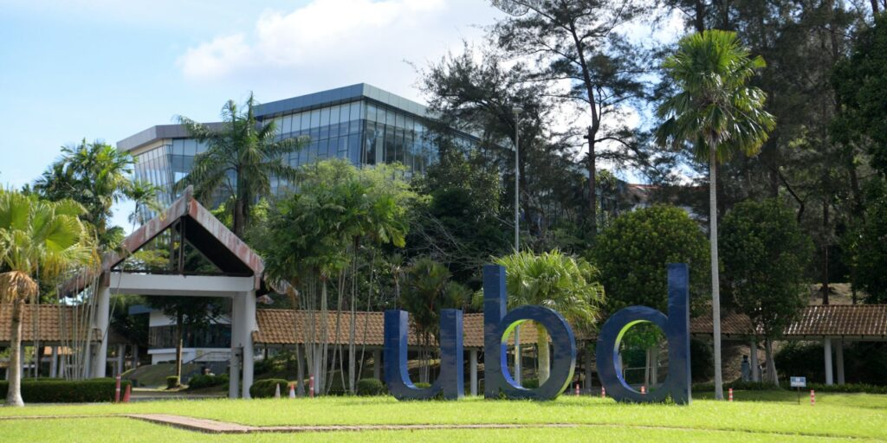
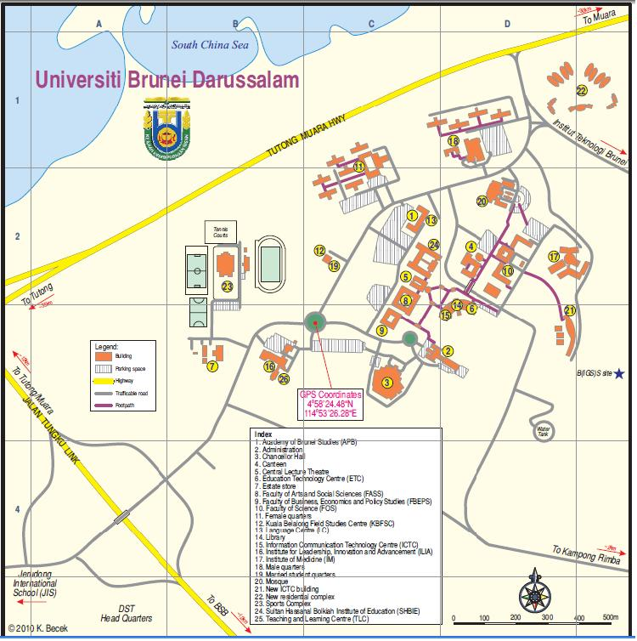

ID: 2XXX
The Title of the Paper for the 3rd Borneo Studies Network Conference on
Smart City Transformation, Biodiversity and Green Supply Chain in Borneo
(36 point font, bold letters)
Names of the Authors (24 point font, bold letters, one line only)
Authors’ Affiliation(s) (20 point font, one line only)
Abstract (24 point font, bold letters)
The abstract submitted for poster for the 3rd BSN Conference is required to use this template to display the summary of the work for poster presentation. Please use this document as a template to form the poster of the given size. You are to type your own text using 20 font size, single-spaced and paste figures and diagrams needed in the poster presentation.
Keywords (22 point font, bold letters) (one line if possible)
IV. Discussions
The 3rd BSN Conference on Smart City Transformation, Biodiversity and Green Supply Chain in Borneo will be held 3-4 June 2025 in Brunei.
The 1st BSN Conference was held in 2018, the 2nd BSN Conference was on June 2021 (Hybrid) due to the pandemic and this 3rd BSN Conference will be held in June 2025.
The contributed and accepted papers to the previous BSN Conferences have been all published in its proceedings and special book edition.
I. Introduction (22 point font, bold letters )
This is the template for preparation of posters 3rd BSN Conference on Smart City Transformation, Biodiversity and Green Supply Chain in Borneo . Please use this document as a sample of the conference poster.
A Smart City Transformation, Biodiversity and Green Supply Chain in Borneo will be compiling the hard copies of all poster papers in a unified style.
The PowerPoint template to produce your conference posters is available at the website.
The abstract accepted for poster presentation MUST have their posters presented in 3rd BSN Conference . Please prepare your poster with this template, and display the hardcopy of the poster at 3rd BSN Conference
II. Principle (22 point font, bold letters )
Describe the basic principle of your research works here.
The scope of the conference includes principally the following topics:
Sustainable Transformation
Green Supply Chain
Biodiversity
Climate Resilience
Circular Economy
Clean Material
Clean Energy
Blue Urbanism
Sustainable City
Energy Economic of Borneo
Fig. 3. Universiti Brunei Darussalam, Brunei.
V. Results and Analyses
There are many hotels not far from the Universiti Brunei Darussalam. Gadong or Kiulap areas are the most convenient ones.
The 3rd BSN Conference does not have ccontract-hotels for participants. However if you need 3rd BSN Conference assistance, please inform us through email bsn@ubd.edu.bn
III. Presentation Template Example
This is the template for preparation of posters for 3rd BSN Conference. Please use this document as a sample of the conference poster.
A. Template of Font (20 point font)
All the items in your poster should be presented as an uniform layout. Do NOT
change the font sizes and font colors in the template.
B. Template of Figures and Tables
More Figures and Tables are preferred for your poster to present your outstanding works in 3rd BSN Conference .
Try to make your Figures are transparent to suit the background colour of the poster. In addition, all the items in the Figures and Tables such as lines, words, symbols are recommended to be identical to the colour of the TEXT in the template (dark green)
Fig. 4. Title of the Figure. (16 point font)
VI. Conclusion
1. Parallel Sessions
2. Post Conference Items
(Detailed information will be updated later)
Fig. 1. Title of the Figure. (16 point font)
Table I. Heading of the Table. (16 point font)
Fig. 2. Title of the Figure. (16 point font)
Model | Feature | Processing | Category
KNN | >200,000 flops | ~10 flops | ~20 flops
NN |  |  | ~10 flops
References (Optional)
[1] X.Y. BSN, Enter main references here, 3rd BSN Conference, Jun 3-4, 2025
[2 ] X.Y. BSN, Enter main references here, 3rd BSN Conference, Jun 3-4, 2025
• Enter your acknowledgements or sponsors here. (Optional) (14 point font)
Author email: XXX@XX.XX
2025 3rd BSN Conference on Sustainable City Transformation, Biodiversity and Green Supply Chain in Borneo, Brunei, 3 -4 June 2025

